Slide 1



Course on
Protein Networks and Systems Biology
14 – 18 December 2015
University of Bologna, IT
Introduction to the SysBiol2015 course: protein interactions, protein networks and systems biology
Allegra Via
Biocomputing Unit
Sapienza Università, Rome, IT

Slide 2
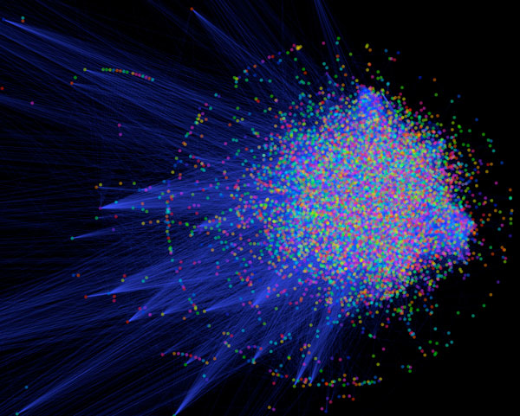
Protein interactions underlie the assembly of macromolecular machines, mediate signaling pathways in cellular networks, and control cell-to-cell communication
Nearly 650,000 interactions regulate human life
In an organism, PPIs form a huge complex network known as an “interactome”
Any deregulation leads to a disease state or death

Slide 3
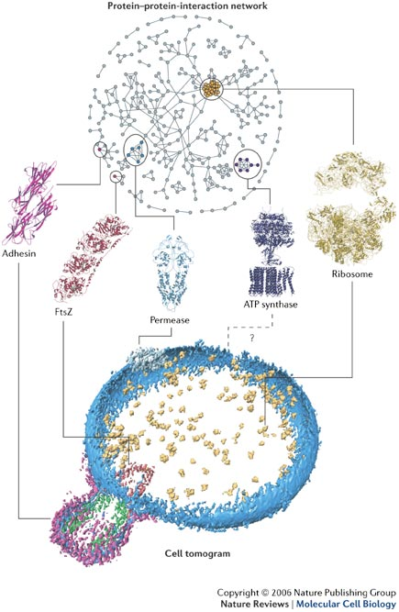
Reductionist biology – molecular viewpoint
Specific molecule(s) of interest
Experiments to determine interaction partners and modes of interaction
Prediction of interaction partners and modes of interaction
Analysis of specific interaction

Slide 4
Protein networks
Identification of functional modules (set of proteins highly connected to each other)
Hubs, singletons
Networks' analysis -> biological hypotheses
Prediction of new interactions
Reductionist biology – molecular viewpoint
Specific molecule(s) of interest
Experiments to determine interaction partners and modes of interaction
Prediction of interaction partners and modes of interaction
Analysis of specific interaction

Slide 5
Protein networks
Identification of functional modules (set of proteins highly connected to each other)
Hubs, singletons
Networks' analysis -> biological hypotheses
Prediction of new interactions
Reductionist biology – molecular viewpoint
Specific molecule(s) of interest
Experiments to determine interaction partners and modes of interaction
Prediction of interaction partners and modes of interaction
Analysis of specific interaction
Systems biology
Networks, pathways implicated in a condition
Identify perturbed or deregulated systems
Modelling of the system to infer to signals and/or deregulation events
Experiments to determine responses of the system

Slide 6
Strong transient: This category includes interactions that are triggered/stabilised by an effector molecule or conformational change. An example is given by the Ras proteins, which form tight complexes with their partners when GTP-bound and only weak complexes when GDP-bound.
Perkins et al, Structure, 2010

Slide 7
Transient vs Stable
Transient (relatively weak)
Brief and reversible interactions occurring in specific cellular contexts
Stable (for a longer period of time)
Proteins take part of permanent complexes as subunits, in order to carry out structural or functional roles
Permanent, obligate, oligomeric, tight, more stable

Slide 8
Examples
Transient interactions
Interactions mediated by short linear motifs
Interactions mediated by PTMs
Disorder-to-order transitions
Proteins involved in signalling cascades
Stable interactions
Homo-oligomeric or hetero-oligomeric complexes
Interactions mediated by PTMs
enzyme-inhibitor
antibody-antigen
domain-domain
domain-peptide
Perkins et al, Structure, 2010

Slide 10
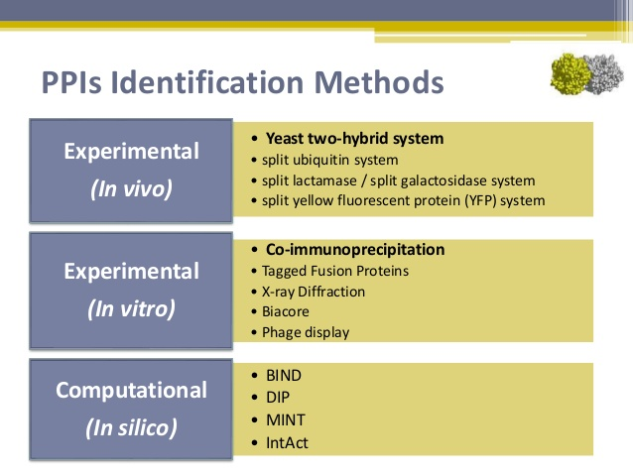

Slide 11
Sable&Jois, Molecules, 2015

Slide 12
What data, tools and standards are around?
Luana Licata
Mon, Dec 14th (15.00-17.30) and Tue, Dec 15th (9.00-12.30)
Bioinformatics tools to study protein-protein and protein-ligand interactions
Collecting, annotating and integrating PPI data: standards initiatives, data formats and data models

Slide 13
A deeper look at PPIs
Rita Casadio
Mon, Dec 14th (17:30-18:00)
Computational perspectives on protein interactions, systems biology and beyond

Slide 14
PPIs from a molecular point of view
Reductionist biology

Slide 15
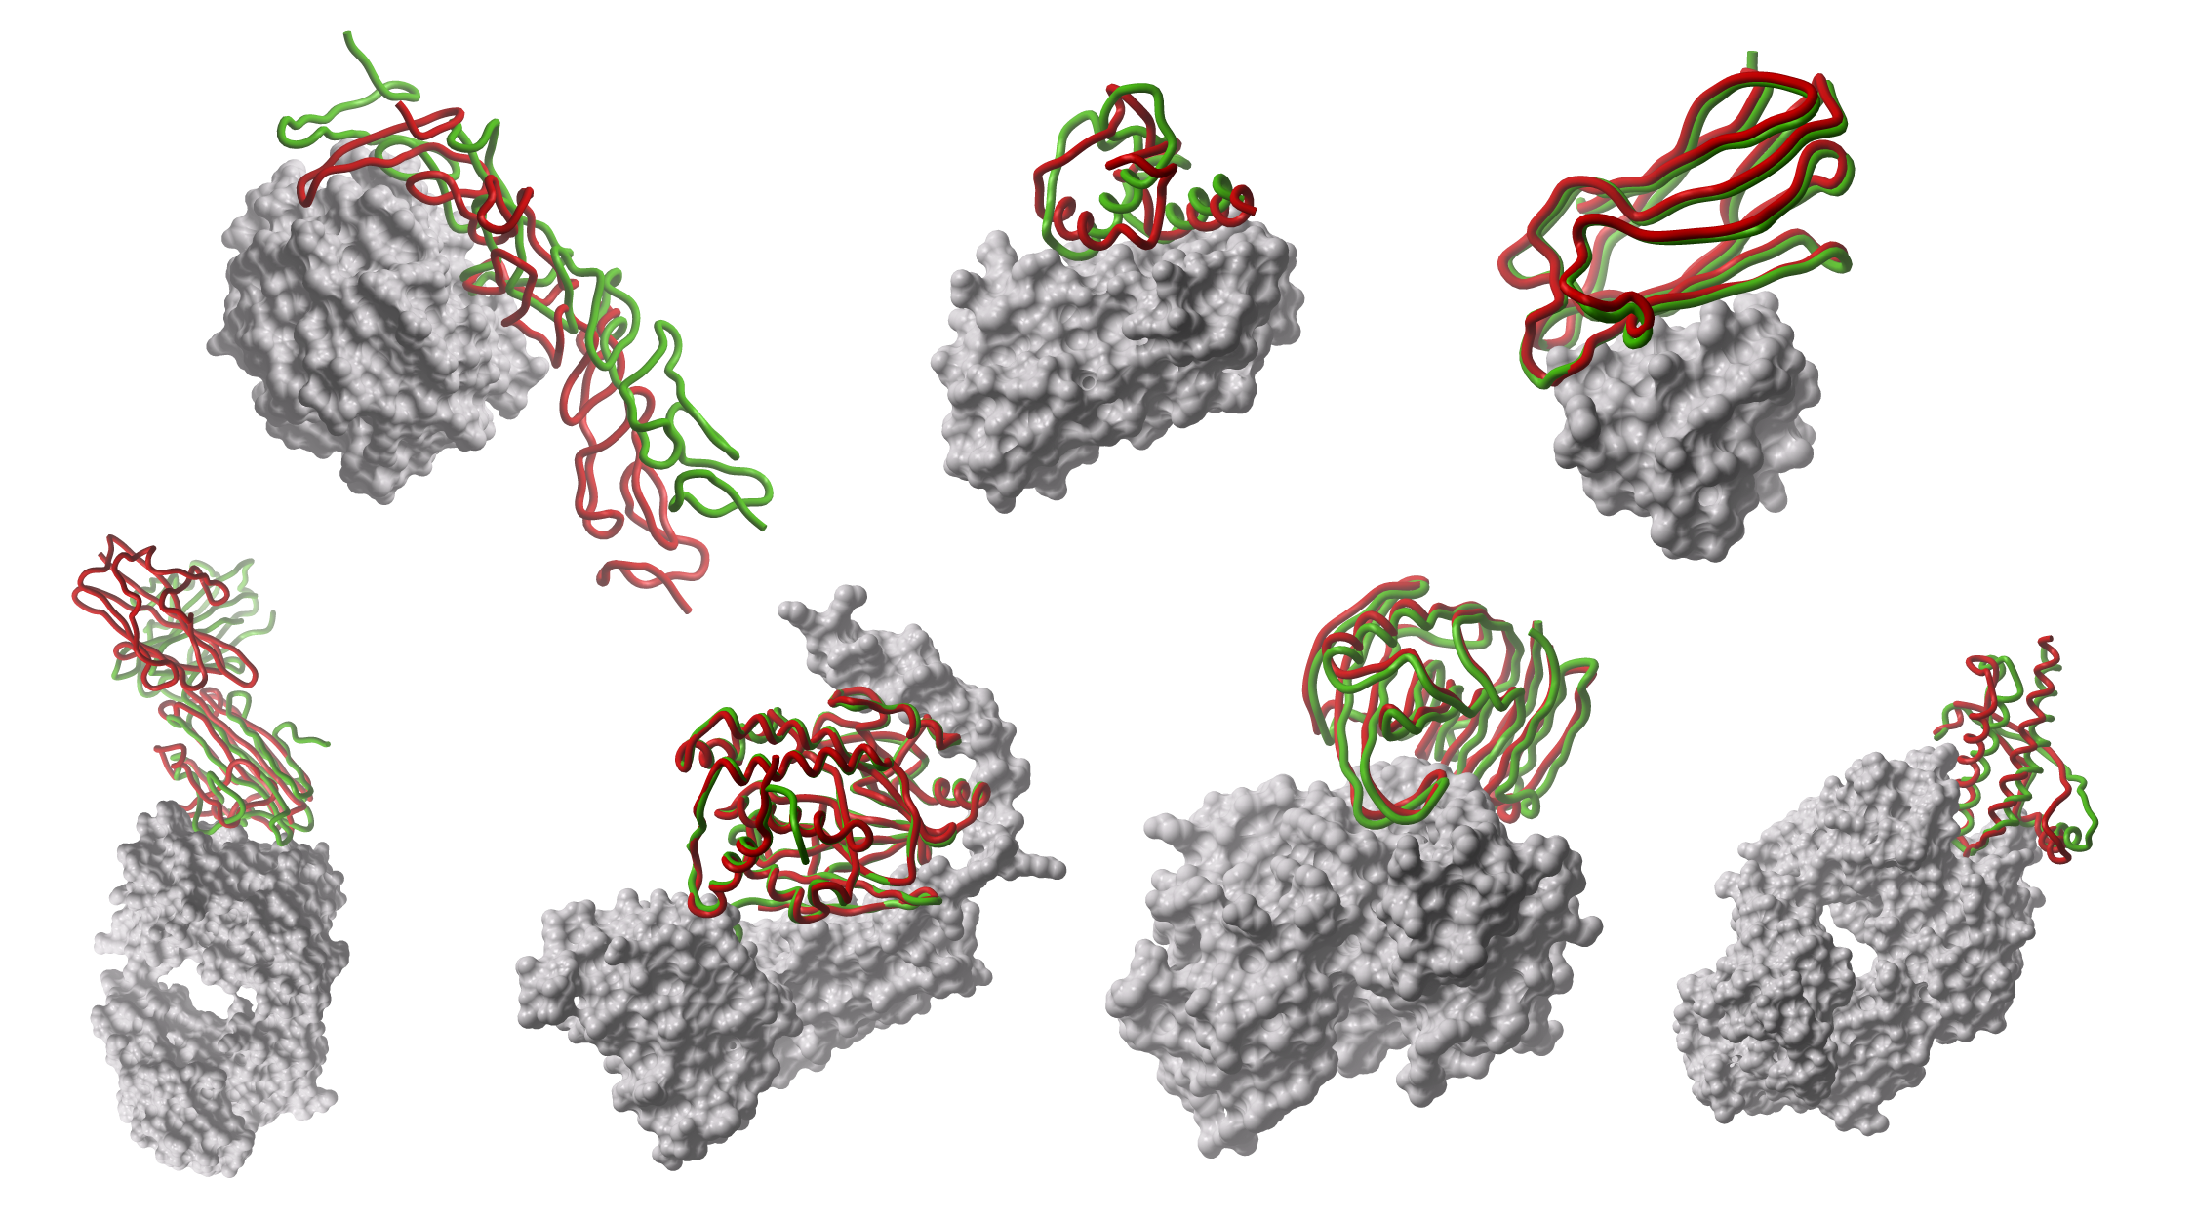
The reductionist approach

Slide 16
Some facts about molecular interactions
The affinity of PPI varies from millimolar to picomolar, depending on the type of interaction and signaling needed (Chen et al. Protein Sci. 2013)
Despite affinity varies over a wide range, proteins maintain a high degree of specificity for their partners
Many proteins exhibit specificity for multiple partners (Reichmann et al. Curr. Opin. Struct. Biol. 2007).
The nature of the interaction surface determines how proteins interact
A detailed knowledge of the interaction surfaces of proteins and their energetics is necessary to understand the regulatory mechanisms of biochemical pathways (especially to modulate or block these pathways for therapeutic purposes)

Slide 17
Some facts about interaction surfaces
The area of PPI interfaces is large (1000 to 4000 Å²)
Standard-sized interfaces are 1200 to 2000 Å²
Short-lived and low-stability complexes -> smaller interfaces (1150–1200 Å²)
large surfaces (2000 to 4600 Å²) ->
proteases and particular inhibitors
G-proteins and other components of the signal transduction system
Protein-small molecule interaction surfaces have an area of 300 to 1000 Å2.

Slide 18
More facts about PPI surfaces
Surfaces of PPIs are generally flat and lack the grooves and pockets that are present at the surfaces of proteins that bind to small molecules
PPI surfaces are generally hydrophobic in nature
Only certain hydrophobic spots contribute to the free energy of binding and help to hold the two proteins together.
Such regions are called hot spots

Slide 19
Some fact about hot spots
Hot spots account for less than 50% of the contact area of PPI
A region of protein surface is called a hot spot when replacement of an amino acid residue by alanine in that spot lowers the free energy of binding by at least 2 kcal/mol
Analysis of the amino acid composition of hot spots shows that some residues are found more frequently in hot spots (Tyr, Trp, and Arg)
The hot spots are surrounded by energetically less important residues that probably separate/prevent bulk water from hot spots

Slide 20
Molecular structure of stable interactions (complexes): what information?
identification of interface residues/hot spots
details about the interface (solvent accessible surface area, shape, complementarity between surfaces, residue interface propensities, hydrophobicity, segmentation and secondary structure, and conformational changes on complex formation)
assignment of protein function
recognition of specific residue motifs

Slide 21
How PPI surfaces can be studied?
The most significant contribution to understanding the PPI surface comes from structural biology via X-ray crystallography or NMR as well as mutational studies
Prediction of interaction/binding sites
Prediction of protein-protein complexes

Slide 22
The reductionist approach
Piero Fariselli
Tue, Dec 15th (14:00-15:00)
Relevant features to predict protein-protein interaction sites
Prediction and analysis of protein 3D complexes
Allegra Via
Tue, Dec 15th (15:00-18:00) - Wed, Dec 16th (09:00-11:30)

Slide 23
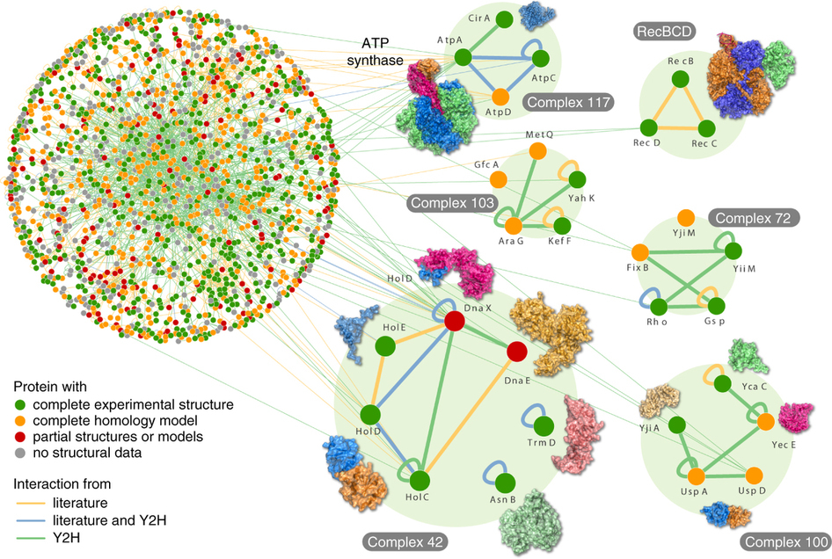
From single interactions to protein networks
Rajagopala et al. Nature Biotechnology 2014

Slide 24
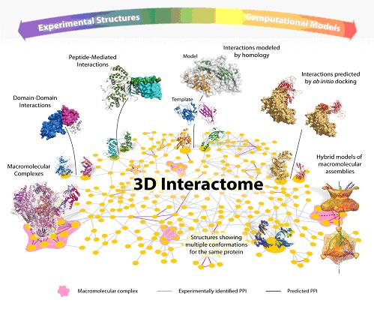
Rita Casadio Wed, Dec 16th (11:30-12:30) From the structure of proteins to large scale protein interactions
http://wikiar2010.bsc.es/index.php5/7.4_Defining_the_3D_Interactome

Slide 25
Protein networks

Slide 26
Protein networks
Cellular processes are typically carried out by protein complexes and functional modules (sets of proteins highly connected to each other)
Identifying them plays an important role for our attempt to reveal principles of cellular organizations and functions

Slide 27
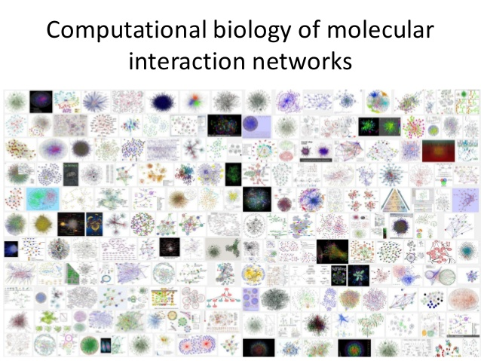

Slide 28
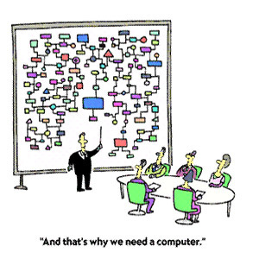
Protein networks
Alberto Calderone
Wed, Dec 16th (14:00-18:00)
Introduction to the graph theory
Biological networks
Analysing biological networks with Cytoscape

Slide 29
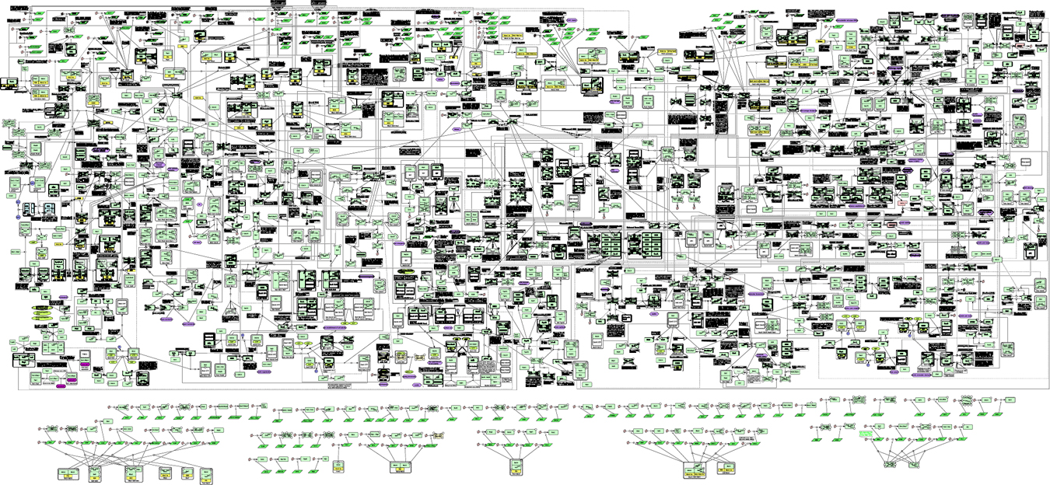
Systems Biology

Slide 30
The whole is something over and above its parts and not just the sum of them all
Aristotle (384-322 BC)
Every object that biology studies is a system of systems
Francois Jacob (1974)

Slide 31
Systems Biology: aim
Understand a biological process performed by a defined system in terms of all its components

Slide 32
Systems Biology: key concepts
Individual components are viewed not in isolation, but as elements of the entire system
Individual properties vs collective behaviour: links levels of organisation
Systematic aspects => list of all components ('omics'), measure all properties and interactions, bioinformatics & computational biology (large scale data integration)
Quantitative aspect => quantitative biology, modelling
A priori, no privileged scale for what represents an interesting biological 'system' => small scale (system = pathway), genome-wide (system = cell) to multi-organisms (system = eco-system)
Lemberger, 2011

Slide 33
From protein networks to systems biology
Alberto Calderone
Thu, Dec 17th (09:00-16:00)
Systems Biology: an overview
Modelling biological systems
…even more!

Slide 34
Ready for the final goal: biomedical applications
Andreas Zanzoni
Thu, Dec 17th (16:00-18:00)
Network biology approaches to understand human disease
Pietro Di Lena
Fri, Dec 18th (09:00-12:00)
Integration of PPI sources and prediction methods: NET-GE: a novel NETwork-based Gene Enrichment for detecting biological processes associated to Mendelian diseases
Gianni Cesareni
Fri, Dec 18th (12:00-13:00)
Signal transduction networks and cell networks: application to the muscle regeneration process

Slide 35
And now…get down to business!

